Slide 1
Building chatbots with MS Bot Framework
Publishing Your Bot

Slide 2
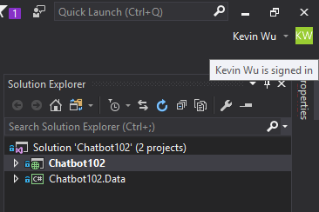
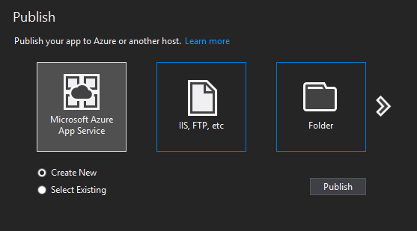
Publish to Azure App Service

Slide 3
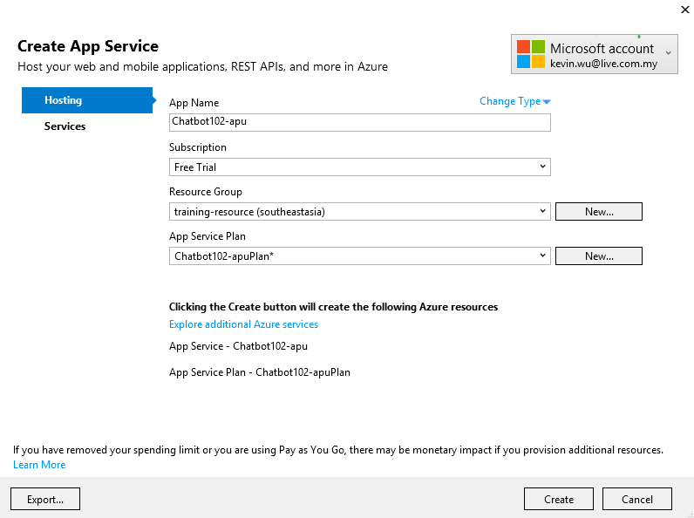
Create App Service

Slide 4
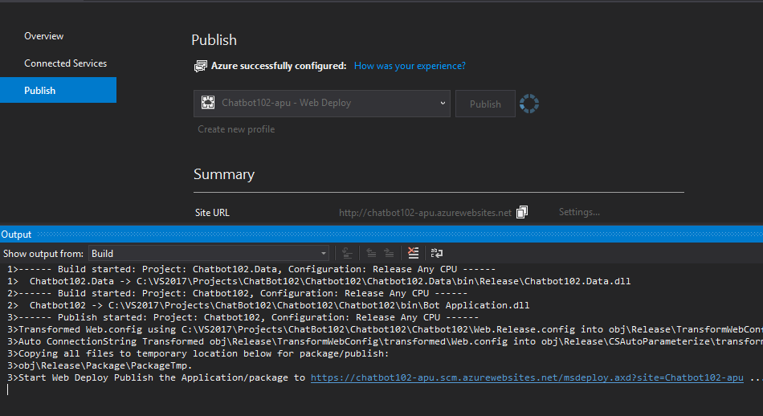
Publishing

Slide 5
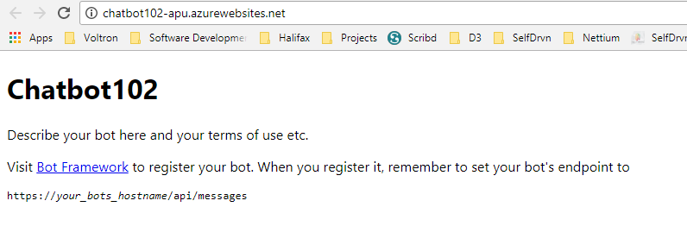
The URL of your chatbot is online!

Slide 6
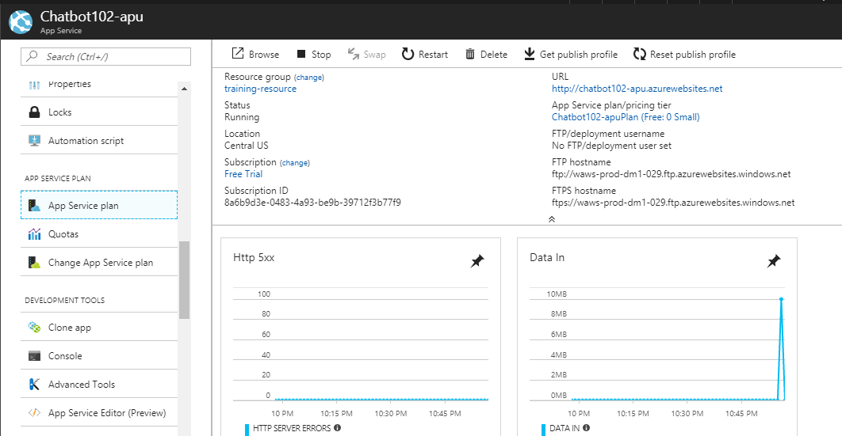
Your App Service on Azure

Slide 7
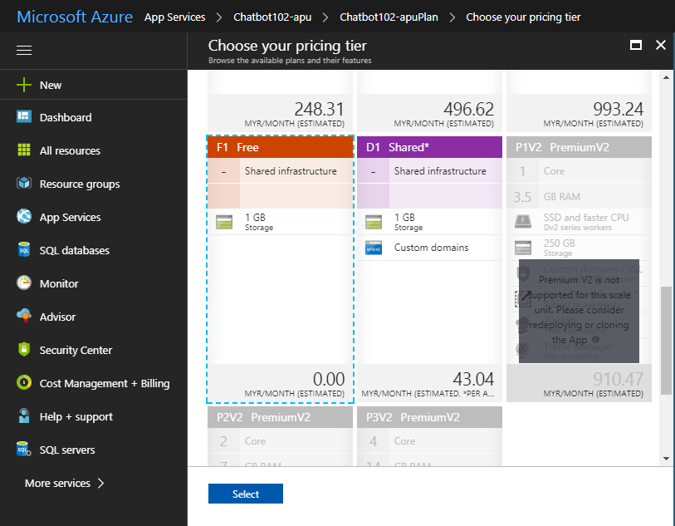
Double-check make sure pricing tier is “F1 Free”

Slide 8
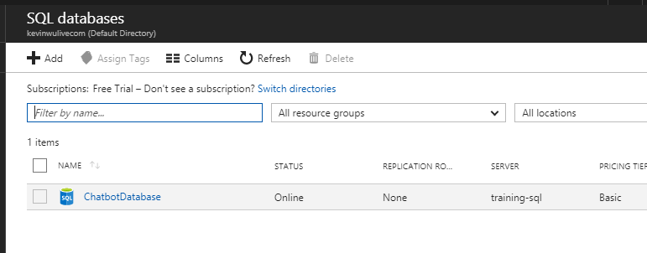
Create “ChatbotDatabase”

Slide 9
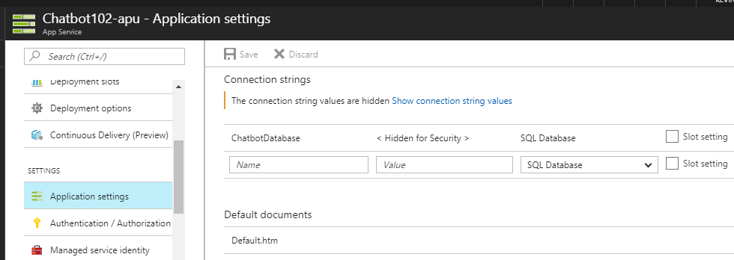
Update Connection String in App Service

Slide 10
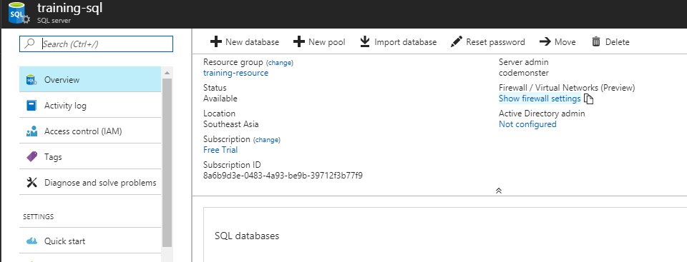
Set firewall in SQL server to access remotely

Slide 11
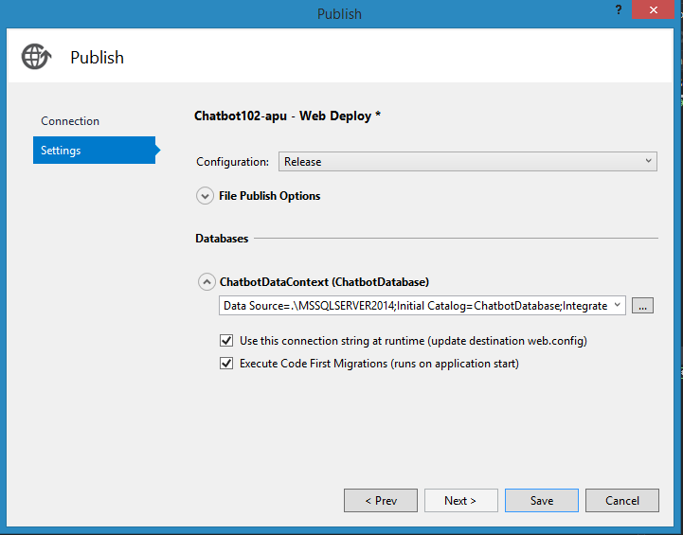
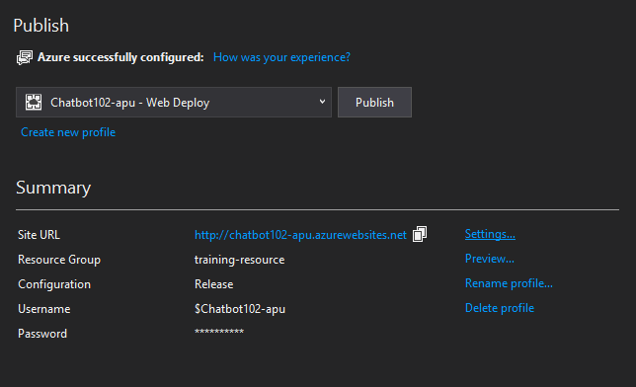
Publish again with “Enabled migrations”

Slide 12
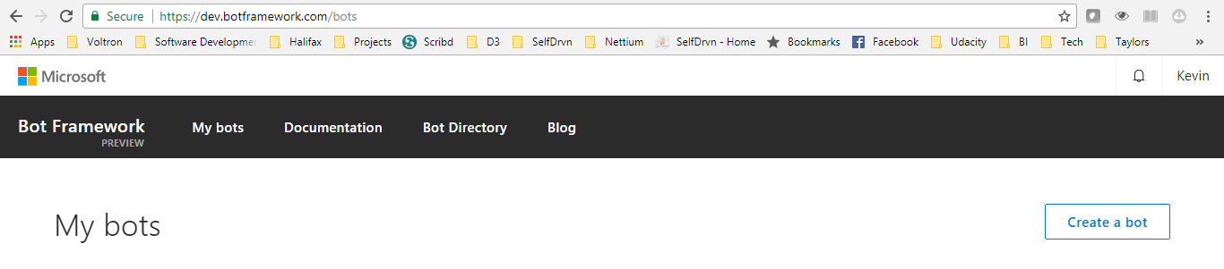
Go to dev.botframework and create a bot

Slide 13
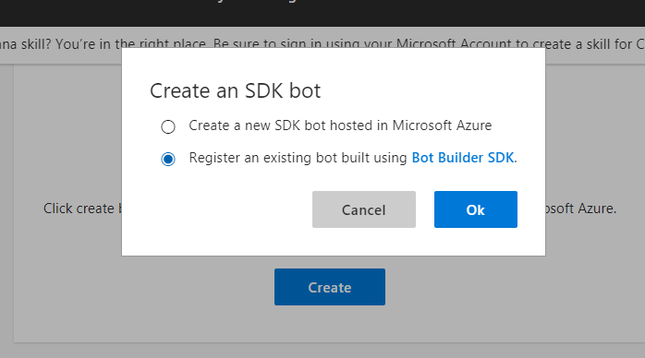
Step 1

Slide 14
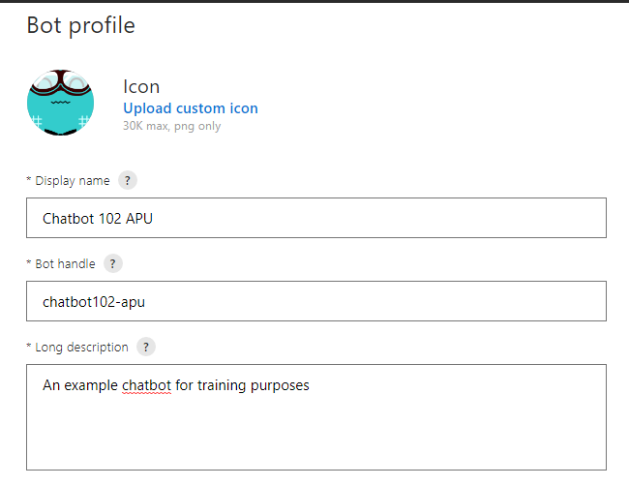
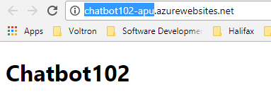
Bot profile
Bot handle is the first part of your bot URL
On Azure

Slide 15
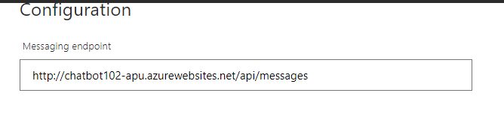
Messaging endpoint is your bot url + “/api/messages”

Slide 16
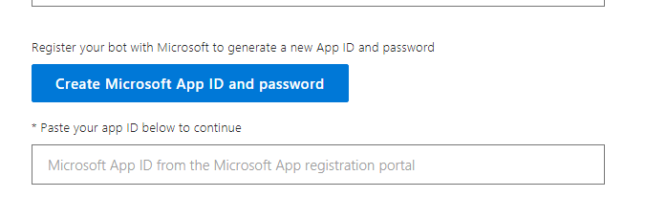
Create and Paste your Microsoft App ID Make sure you copy your App ID and Password!

Slide 17
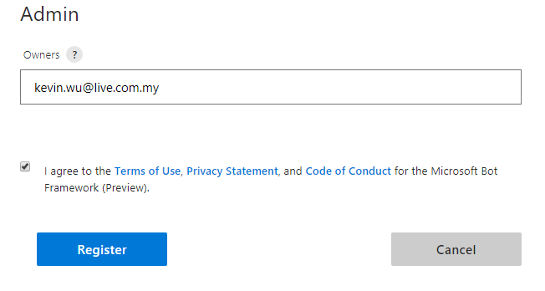
Agree to Terms and Register!

Slide 18
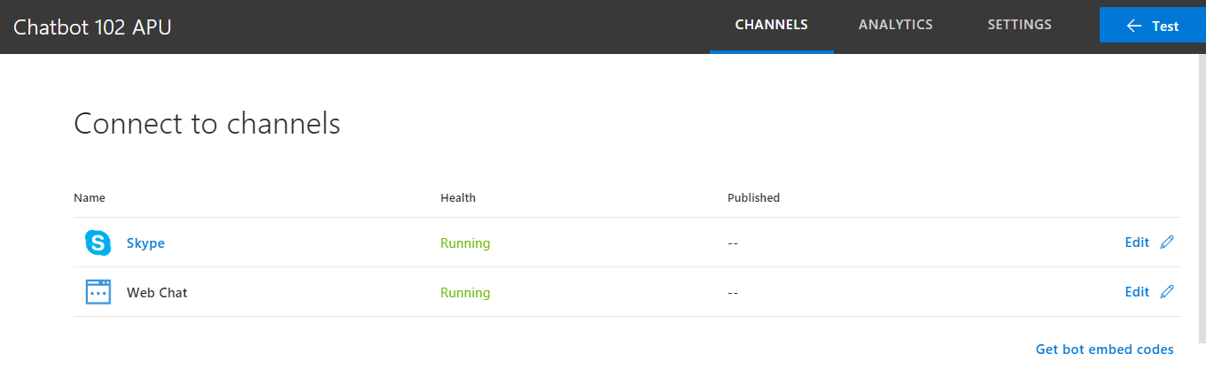
You should see your bot’s channels

Slide 19
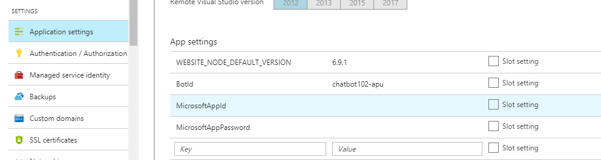
Go back to Azure App Service… update the BotId, MicrosoftAppId, AppPassword

Slide 20
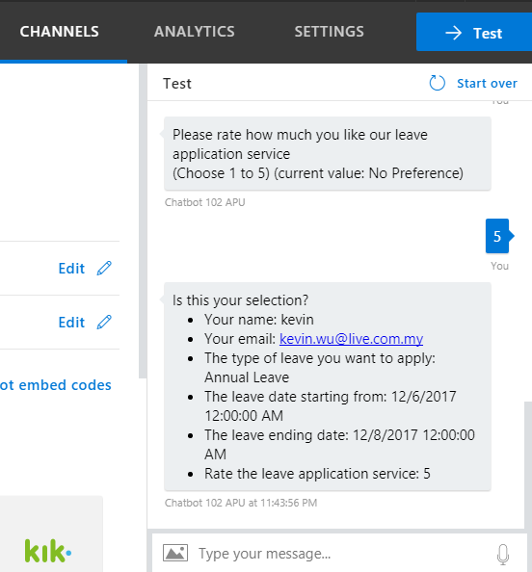
Test!

Slide 21
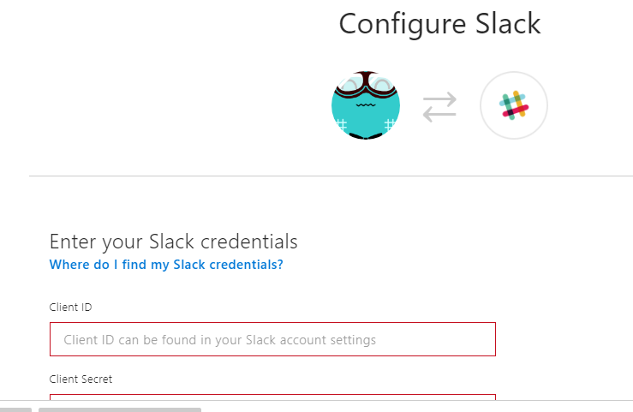
Configure Slack
https://docs.microsoft.com/en-us/bot-framework/channel-connect-slack

